Slide 1
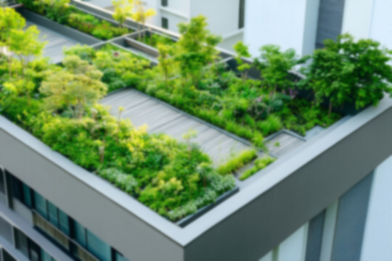

Rooftop Gardening
A warm welcome to our rooftop garden story.
1

Slide 2

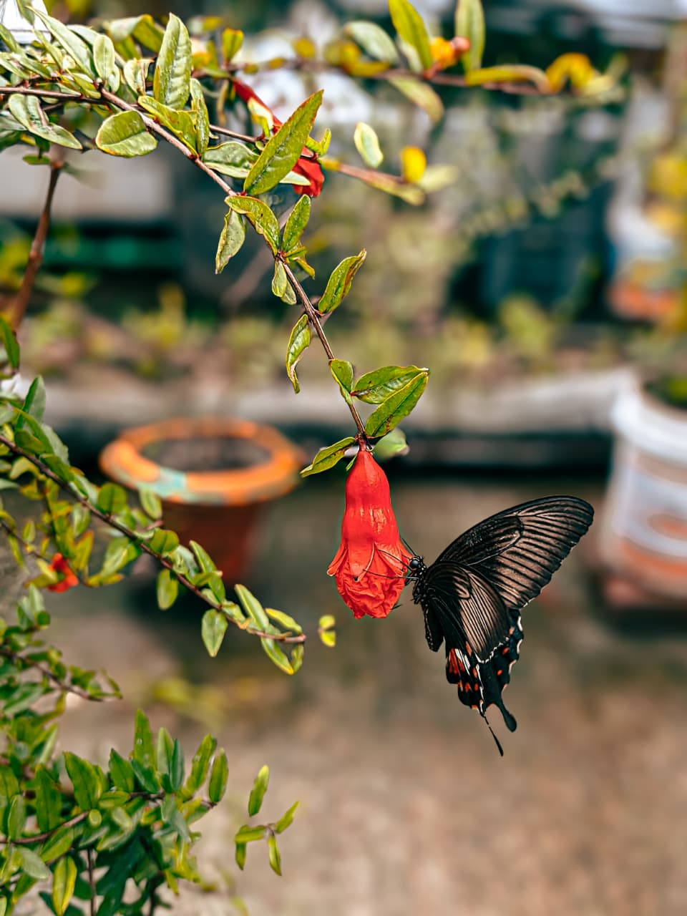
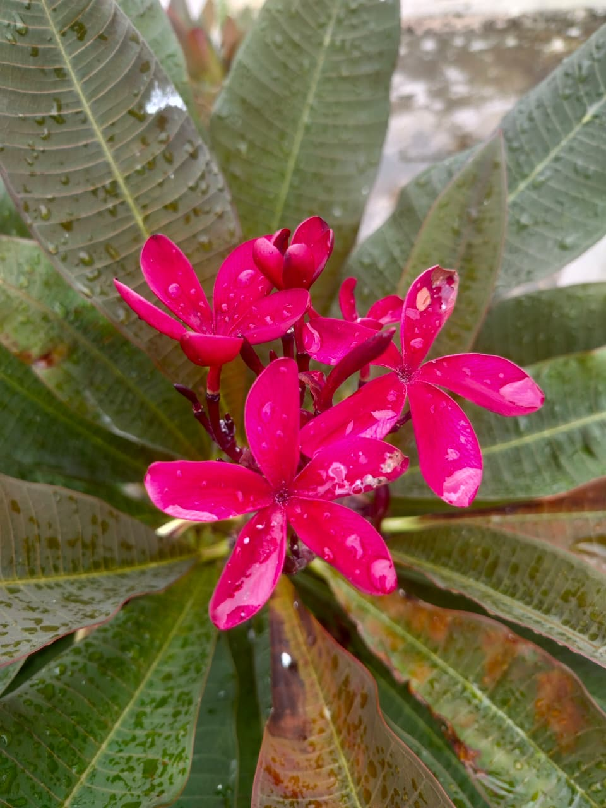
English Reading and Public Speaking
Presenting by
Power
Rangers
Program: Data Science
Section: B11
Presented to: Shihab Saqib
Faculty, Department of English
2

Slide 3




Group Introduction
Talha Faiyaz
Souvick Das Lobdhi
Purba Mondol
3

Slide 4
Today what we will cover?
Introduction of Rooftop Gardening
Essentials Elements
Benefits of Rooftop Gardening
Impact on Urban Life
Maintenance and Common Plants for Rooftop Garden
Challenges and Solution
4

Slide 5


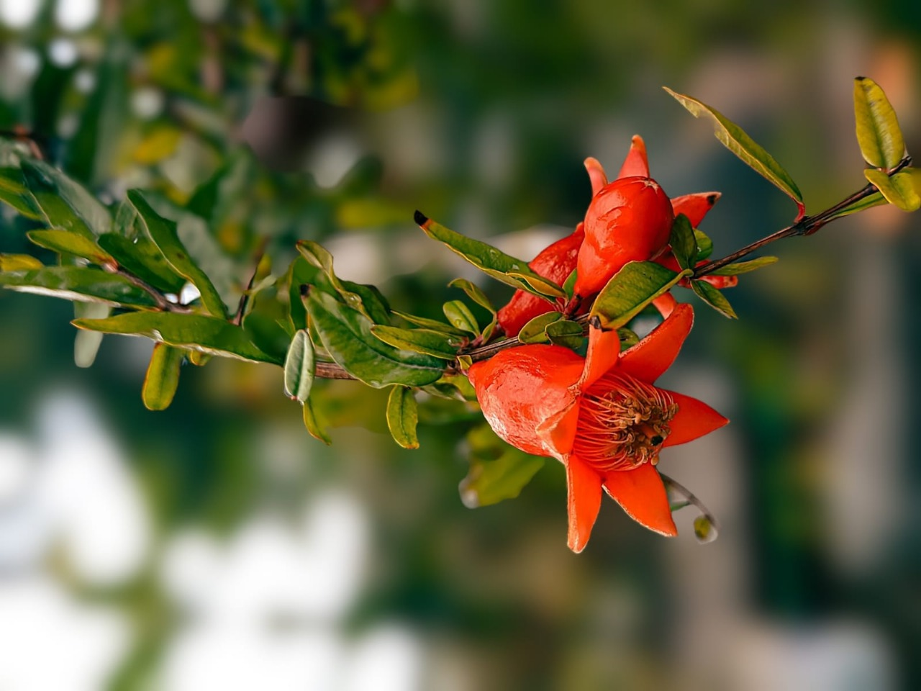
Introduction To Rooftop Gardening
Definition of Rooftop Gardening
Visual Example
Relevant to Dhaka City
Growing trend in Bangladesh
5

Slide 6
Essential Elements
Strong Roof Structure
Waterproofing & Drainage
Quality Soil & Fertilizers
Proper Irrigation
Plant Selection
6

Slide 7
Benefits Of Rooftop Gardening
Produce your own fresh food – no chemicals
Purifying air and satisfying atmosphere
Great for mental health and serenity
Reproduce new plants for free and sell them
Produce Oxygen and help environment
Proper usage of space and storage
7

Slide 8
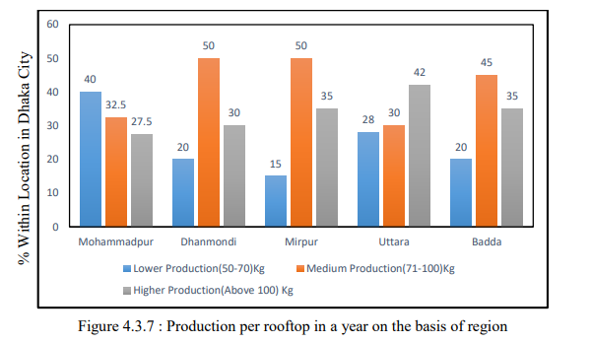
Impact On Urban Life
Ref. - DEPARTMENT OF AGRIBUSINESS AND MARKETING SHER-E-BANGLA AGRICULTURAL UNIVERSITY DHAKA- 1207
Maisa Taslim Washi
STUDY ON ROOFTOP GARDENING AS AN AGRIBUSINESS PRACTICE IN DHAKA CITY
8

Slide 9
Maintenance & Common Plants For Rooftop Gardening
Watering and Soil Care after planting
Trimming and weeding, Pest Control
Plant Selection
Common Types : Herbs & Vegetables
Flowers and Medicinal Herbs
9

Slide 10
Challenges And Solutions
Heavy weight and root strength
Water leakage – Damping the structure
Strong wind might destroy tall trees
Heat from the scorching sun
Space & Storage issue for small rooves
10

Slide 11
Conclusion
Smart solution for greenery in crowded cities
Future of planting and harvesting
Perfect use of sunlight and rooftop space
Making beautiful greenery and scenario
Helping economy and individuals
11

Slide 12
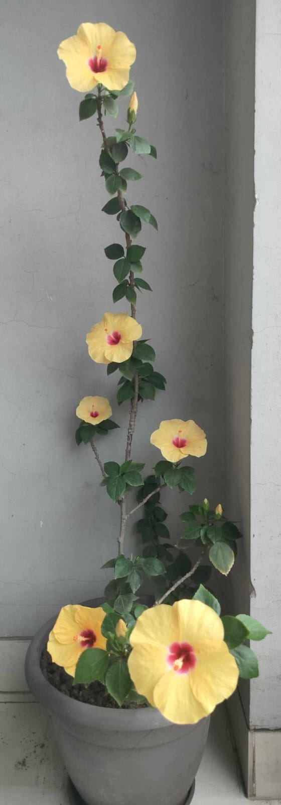
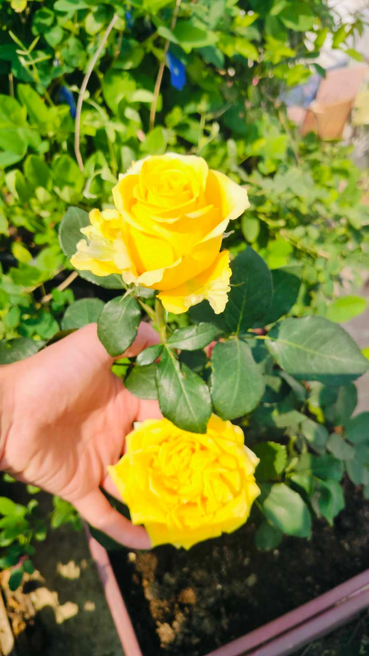
Thank You
12

